Slide 1
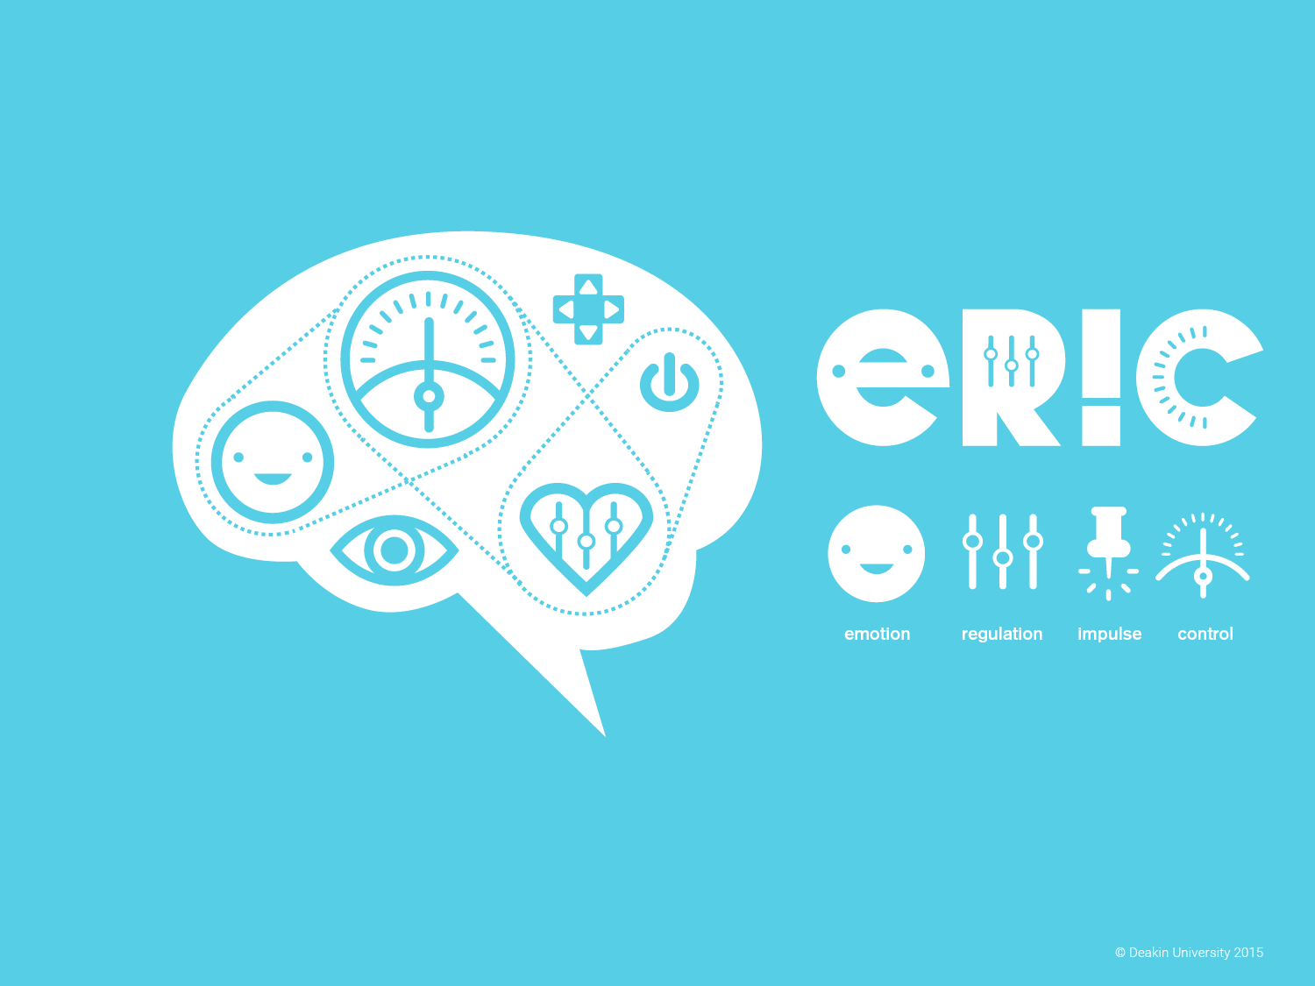

Dr Kate Hall
Clinical Psychologist & Senior Lecturer in Addiction and Mental Health

Slide 2

What is ERIC?
ERIC applies an emotion regulation framework to working with young people. ER is an underlying mechanism for emotional, behavioural and interpersonal difficulties.
Difficulties regulating emotions are associated with mental health and substance use issues.
Difficulties regulating emotion occurs as a result of attachment disruption in relationship with primary caregivers.

Slide 3
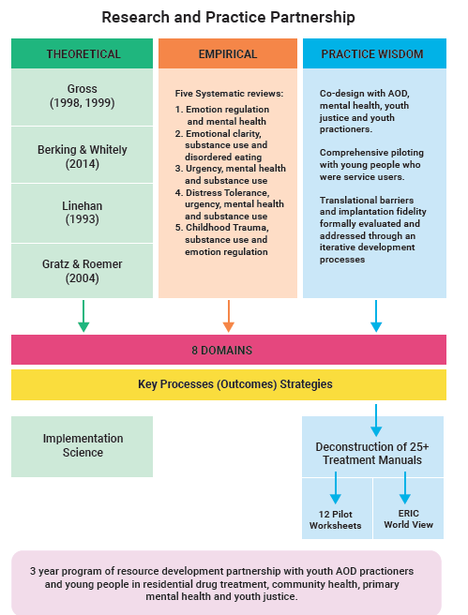

Slide 4
Multidimensional Model of Emotion Dysregulation (Gratz & Roemer, 2004)
  The awareness, understanding and acceptance of emotional experiences
  Ability to control impulsive behaviours when experiencing negative emotions & engage in goal directed behaviours
  Flexible use of non-avoidant situationally appropriate strategies to regulate emotions in order to meet individual goals or situational demands
  Willingness to experience negative emotions as part of pursuing meaningful activities in life

Slide 5
ERIC’s Definition
Emotion Regulation
  Allowing, naming and accepting emotions without trying to change them;
  using effective emotion regulation strategies when distressed that match the context;
  inhibiting unhelpful impulsive behaviours when strong emotions are triggered;
  focussing on goal or value-directed behaviour when strong emotions are triggered;
  calming down or self-soothing after becoming distressed.
Notes:
Transdiagnostic models provide a parsimonious way of explaining the comorbidity between disorders by highlighting core disturbances that are evident across disorders. In essence they emphasise the similarities of the features of mental health and substance use disorders, rather than focussing on their differences. This approach has been used to inform ERIC in order to target multiple presenting problems simultaneously.

Slide 7
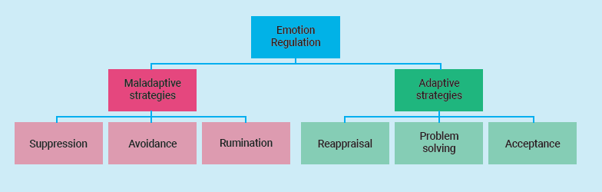
Gross’ Process Model of Emotion Regulation (1998a, 1998b)
The set of strategies that individuals may use to increase, maintain or decrease their affective experience

Slide 8
ER & anxiety, depression, substance & eating disorders
Aldao et al (2010) did a meta analysis that asked which emotion-regulation strategies are most strongly associated with psychopathology?
ER Strategy | Effect Size, for relationship with symptoms of psychopathology
Acceptance | Small (non-significant)
Avoidance | Medium - large
Reappraisal | Small - Medium
Rumination | Large
Suppression | Medium to large
Problem Solving | Medium - large
Finding 1: The presence of a maladaptive emotion-regulation strategy is more deleterious than the relative absence of adaptive emotion-regulation strategies and predict symptoms at 1 year follow up (Aldao and Nolen-Hoeksema, 2012).
Finding 2: The exception may be problem solving;
A. Aldao et al. / Clinical Psychology Review 30 (2010) 217–237
Notes:
Found that the effect size for rumination was large;
The effect sizes for avoidance, problem solving, and suppression were medium to large;
The effect sizes for reappraisal and acceptance were small to medium (non-significant for the latter).
Thus, in general, the maladaptive strategies were more strongly related to anxiety, depression, eating disorders and substance abuse than the adaptive strategies.
not having a strong problem-solving may have wide-ranging negative effects on well-being, and open the door for the development of maladaptive emotion-regulation strategies such as rumination, suppression, and avoidance

Slide 9
Does Emotion Regulation Mediate the Relationship Between Childhood Trauma and Problematic Substance Use in Young People? A Systematic Review
Brogan Nunn, Kate Hall & Richard Moulding
Emotion Regulation
Childhood Trauma
Substance Use
Figure 3.1. The mediating role of emotion regulation in the relationship between childhood trauma and substance use.
Notes:
This literature shows that ER is profoundly impacted by early life experience with your care givers. From a developmental perspective, emotion regulation IS Attachment to your care giver.

Slide 11
% over the clinical cut off
Notes:
Our young people have different patterns of mental health complexities than adults and young people who access tertiary MH services

Slide 12
Three Classes of ER strategies
Ruminators/avoiders
High adaptive
Low maladaptive adaptive
Notes:
This study aimed to explore:
how classes of ER derived from a treatment seeking sample of young people differ from those found in a non-clinical sample by Dixon-Gordon et al. (2014);
whether the inclusion of overt ER strategies adds to the current understanding of young people’s repertoires of ER, and
whether these ER strategies also relate to greater levels of substance use symptoms in addition to those of other disorders.
This study identifies three distinct repertoires of ER strategies likely to be utilised in response to an emotionally eliciting event by individuals receiving treatment in youth AoD and mental health services.

Slide 13
How do these repertoires of ER strategies relate to symptoms of depression, anxiety, substance, eating and borderline personality disorders
Maladaptive ER use is particularly damaging

Slide 14
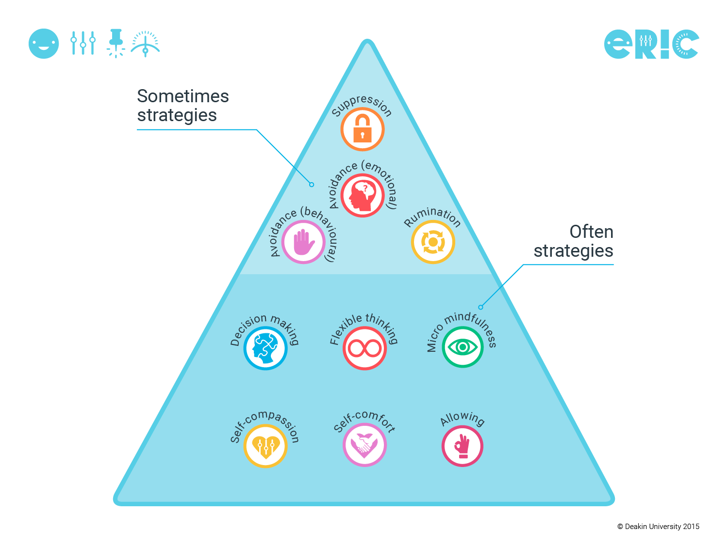

Slide 16
Aim:
  First systematic review to examine changes in ER after psychological treatments across depressive, anxiety, substance use, eating-related disorders and Borderline Personality Disorders.
Method:
  958 titles screened, 123 full text review, 53 articles met full criteria.
Results:
  regardless of the intervention or disorder, emotion dysregulation significantly decreased following effective treatment
Rumination mediated the effect between treatment outcomes in 7 studies of anx and dep.
Notes:
1. ER is changes after intervention
2. Rumination is an important mediator

Slide 17


Notes:
That was a relief – because I think by that stage we had already paid for the logo.

Slide 18
8 ERIC Domains
Notes:
The ERIC domains target important processes for the development of emotion regulation and impulse control.

Slide 19
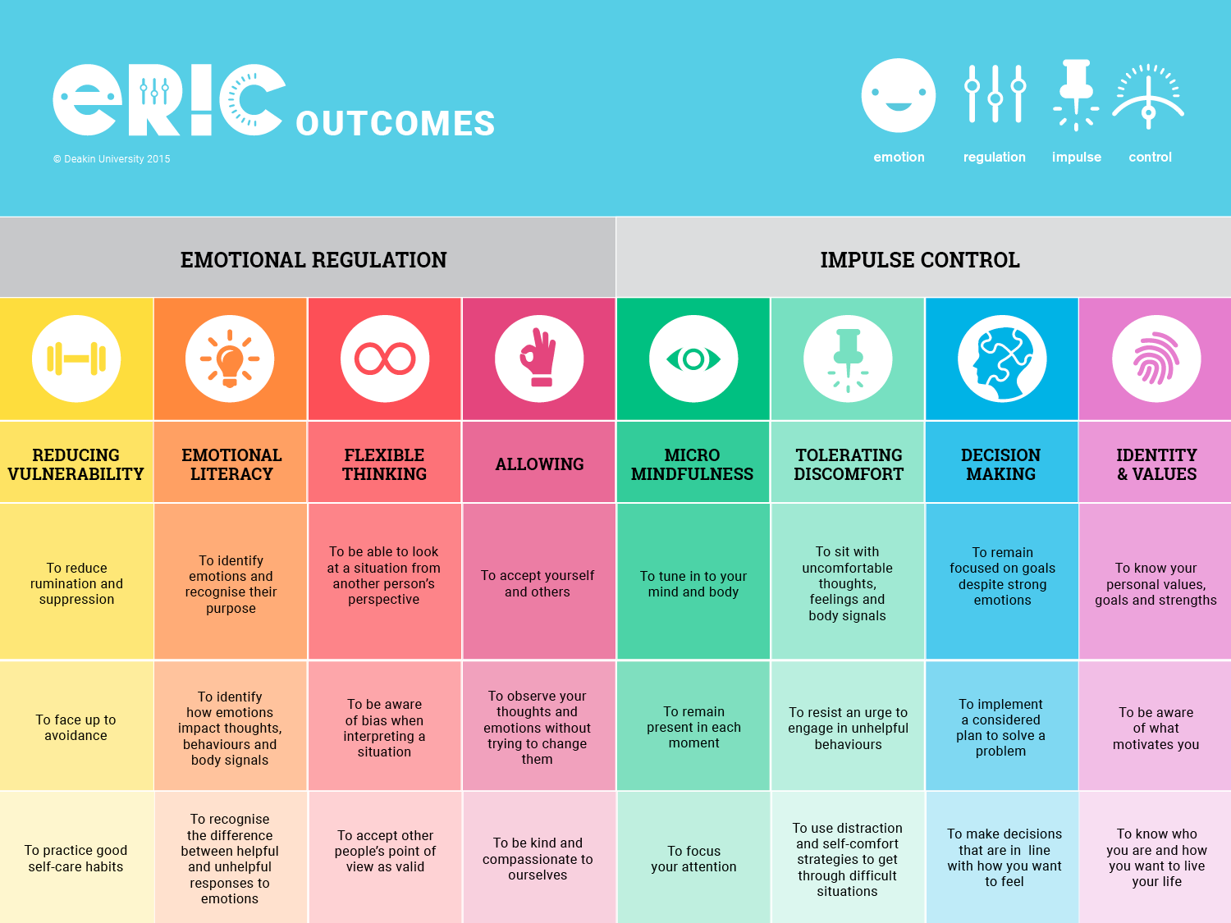

Slide 25



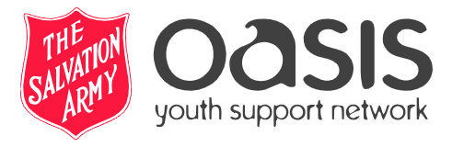


NSW Health AOD Innovation Grants
ERIC (Emotion Regulation Impulse Control): a sustainable program for vulnerable young people with AoD and mental health issues.
Sydney Local Health District, The Sydney Children’s Health Network, Oasis Youth Support Network Sydney (Salvation Army), Salvation Army FYRST (Liverpool), CatholiCare and Youth Off the Streets.

Slide 26
Research Question/Aim 1
Does engagement in ERIC alongside existing AOD treatment have an impact on a young persons:
    Engagement in prosocial behaviours
    Quality of life
    Emotion Regulation
    Drug and alcohol use
    Mental health and wellbeing
Recruitment of 300 young people aged 16-25
Completion of a short questionnaire examining the above before and after ERIC
Young person receives ERIC across a three month period alongside existing treatment

Slide 27

Research Question/Aim 2
To assess whether ERIC is a practical or feasible intervention to implement across the NSW health sector
Clinician and manager participation in focus group/interviews to help determine:
  Satisfaction
  Feasibility
  Appropriateness
  Fit with organisational culture
  Logistical concerns
  Barriers & challenges of implementing ERIC in NSW health

Slide 28




Our young people?
65 young people completed the baseline assessment
20 years mean age
58% Male
22% LGBTIQA
9% identified as ATSI
32%
have been involved in the criminal justice system
58%
Have experienced abuse or neglect in their lifetime
54%
have experienced
homelessness

Slide 29





Mental Health
69%
Self reported
mental health Dx
73% two or more
mental health Dx
24%
Past suicide attempt
68%
Have had thoughts of self harm

Slide 30
Mental Health
Notes:
Vic clinical n+300

Slide 31
Lifetime Drug Use
95%
Alcohol
89%
Cannabis
60%
Cocaine
58%
Hallucinogens
57%
Methamphetamines

Slide 32
Emotion Regulation
Emotion Regulation
Difficulty engaging in goal directed behaviour
Impulse control difficulties
Lack of emotional awareness
Non-acceptance of emotional responses
Lack of emotional clarity
Limited access to emotion regulation strategies
Mean age of sample
20 years
21 years
20.7 years
* Cui, M., Darling, C. A., Lucier-Greer, M., Fincham, F. D., & May, R. W. (2018). Parental Indulgence: Profiles and Relations to College Students’ Emotional and Behavioral Problems. Journal of Child and Family Studies, 27, 2456-2466.

Slide 33
ERIC developed by:
Kate Hall & Angela Simpson
Team Acknowledgements
Associate Professor Petra Staiger (Deakin University)
Professor Amanda Baker (University of Newcastle)
Dr Richard Moulding (Deakin University)
Dr Alison Beck (University of Newcastle)
Dr Natasha Perry (Hunter New England Health)
Dr Elise Sloan (Deakin)
Bonnie Wells (Deakin University and YSAS)
Partners
Birribi Residential Rehabilitation, VIC
YETI, Cairns, QLD
Grampians Community Health, VIC
Ballarat Community Health, VIC
Nexus Primary Health, VIC
Gateway Health, VIC
Hunter New England Health Service, NSW

